Slide 1

Comcom Project (2hrs)

Slide 2
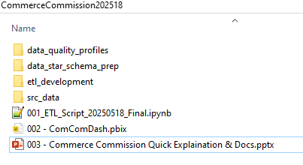
A well planted seed yields a beautiful harvest
Deliverables here (Power BI, ETL Script, Documentation)
DATA ACQUISITION & PREPARATION PHASE (~1hr)
Refer notes pane
Notes:
Data Acquisition and Preparation (~1hr)
OBJECTIVES:
Consider that we wish to source this data on an ongoing basis for use by multiple analysts.
Clean / format for suitable analysis. Document steps and assumptions made in a notebook (CommerceCommission202518 \ 001_ETL_Script_20250518_Final.ipynb)
Ensure that your data acquisition and preparation process can be easily repeated.
NOTES ON WORKFLOW
10 mins – Acquired datasets & placed locally (can develop Web Scraping functionality at a later time as just need the data to build an end-to-end data lifecycle pipeline within limited time and with the actual data at the moment)
- Wrote code (001_ETL_Script_20250518_Final.ipynb) to ingest data from csv and shape files (files placed in CommerceCommission202518\src_data\) directory as well as code to execute the automated Ydata Data Quality Framework tool
- Setup Github (for version control and organisation of project, saving/loading of data and scripts)
50 mins – Used Ydata Data Quality Framework as the automated Data Quality Tool (using a low powered cloud-based notebook this took time to run – 20-30mins)
- This framework was chosen as it provides auto generated tables, charts, and alerts (measures, monitors, is opensource version used in Microsoft Purview) which support the determination of ….
• Accuracy: Correct and reliable data values.
• Completeness: No missing or null values.
• Consistency: Uniform format and meaning across datasets.
• Timeliness: Up-to-date data.
• Validity: Compliance with defined formats or standards.
• Uniqueness: Avoiding duplicates.
• Schema Validation: Check for data type mismatches and field count.
• Range Checks: Check for data type mismatches and field count.
• Format Validation: Use regular expressions to validate email addresses, phone numbers, etc.
• Metadata Management: Maintain metadata to track data lineage and transformations.
• Duplication/Outlier/In-appropriate data type detection, missing data, understanding relationships/interactivity between data, etc.
• Output report is a html file located here (highlighted) …
| -- CommerceCommission202518 (main directory/root repository which includes the two files required for this project - ETL script and the Power BI tool)
| ------ data_quality_profiles (Storage of Ydata Data Quality Automated Framework Outputs – interactive html that allows users to examine alerts and data)
| ------ data_star_schema_prep (Storage of star schema outputs resulting from ETL processing via python/spark code contained in notebook)
| ------------ dim_geospatial.parquet
| ------------ dim_location.parquet
| ------------ dim_geospatial.parquet
| ------------ dim_location.parquet
| ------ etl_development| (My coded/documented modularised ETL and utilities/testing classes (with functions) called by code in the notebook)
| ------------ etil
| ------------ utils
| ------ src_data (Data required (tenancy and shape files) and sourced by code in the notebook)
- During the running of the Data Quality Tool (DQT) I wrote boiler code functions to support ETL processes and pipeline code to execute the process
- Examination of the DQT results were then examined and used to curate/refine the ETL code. DQT was rerun until data/monitoring processes provided decent results and a stable replicable data pipeline
- The final code which runs the pipeline is located in the root directory CommerceCommission202518 \ 001_ETL_Script_20250518_Final.ipynb
- The final functions and classes used to perform ETL, which the main script references to, are located in etl_development \ etil
- this supports modularisation, quick testing, reusability (across other scripts), of separate functions and classes.

Slide 3

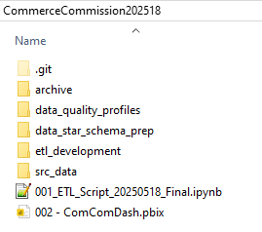

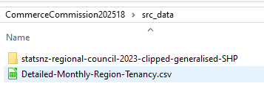
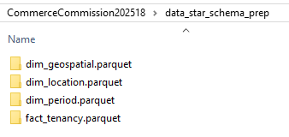

Many streams make a river
ETL Script sources, processes, and integrates data
from the src_data directory (can be cloud/github based)
A (1) Data Quality Profile Report and a (2) data star schema are produced
(in data_star_schema_prep directory which can be cloud storage based)
of which is made available to applications.
DATA INTEGRATION PHASE (1/2 hr)
Refer notes pane
Notes:
2. Data Integration (maybe ~10 - 30 mins as included as part of the data acquisition and preparation coding phase)
OBJECTIVES:
Think about how analysts could house this data in a central cloud data warehouse location for easy access (refer ETL/Data Preparation phase below)
Briefly describe how you would manage and organise the data for efficient retrieval and analysis. (refer Personal Opinion below)
NOTES ON WORKFLOW
| -- CommerceCommission202518 (main directory/root repository which includes the two files required for this project - ETL script and the Power BI tool)
| ------ data_quality_profiles (Storage of Ydata Data Quality Automated Framework Outputs – interactive html that allows users to examine alerts and data)
| ------ data_star_schema_prep (Storage of star schema outputs resulting from ETL processing via python/spark code contained in notebook)
| ------------ dim_geospatial.parquet
| ------------ dim_location.parquet
| ------------ dim_geospatial.parquet
| ------------ dim_location.parquet
| ------ etl_development| (My coded/documented modularised ETL and utilities/testing classes (with functions) called by code in the notebook)
| ------------ etil
| ------------ utils
| ------ src_data (Data required (tenancy and shape files) and sourced by code in the notebook)
In summary the code (CommerceCommission202518 \ 001_ETL_Script_20250518_Final.ipynb) provides the following:
INGESTION/TRIGGER: Although webscraping data directly and downloading to some ingesting storage space is ideal (requires some time to code and acquiring permission and understanding from providers is needed), the code acts upon data being somehow loaded into CommerceCommission202518 \ src_data directory (in any cloud storage/ingestion space) then building a triggering step for the ETL script (currently it is manually executed).
ETL/Data Preparation: The ETL script, automatically monitors for data alerts (output is in the data_quality_profiles directory) , curates, and then integrates the data (ETL phases) creating a star schema-based data warehouse leveraging parquet formatted files located here (CommerceCommission202518 \ data_star_schema_prep ) and is illustrated above. The options here are:
…. Either porting the prepared data warehouse data straight into a relational database (i.e. SQL Server, Snowflake, etc.) from the parquet files
…. Or leaving the data in parquet files as is (i.e. parquet files are more acquainted to modern and incoming future architectures and analytics) and directly ingesting into applications (i.e. Power BI, Snowflake, Databricks, Fabric, Synapse, etc.).
Personal Opinion: After nearly 10-20 years developing data warehouses, I now tend to favour leveraging PARQUET as a stateless data warehouse (in contrast to a relational persistent data warehouse). Retireval and analysis can be done in Snowflake, Fabric, Synapse, most languages, etc. (looks and works much like past warehouses but the backend is all PARQUET based). The ETL script handles everything as it stands (and can be ported and/or incorporated into the applications mentioned). The only need is to connect the applications/tools to the generated files.

Slide 4
This map is not the territory
ANALYSIS, VISUALISATION, This DOCUMENT (1/2 hr although much unaccounted time went into repairing fabric/power bi & writing this document)
Refer notes pane
Notes:
3. Data Analysis and Visualization (10 - 30 mins as included as part of this documentation being written)
OBJECTIVES:
Analyse the data to uncover interesting trends and patterns, document this exploratory analysis if considered relevant.
You might like to answer questions such as:
Which region has the highest rent?
Where are rents changing the fastest?
Are there any real-world events that could be linked to observed trends?
Using Power BI to create visual representations of your findings.
Optionally, use the provided regional council boundaries shapefile to enhance your analysis and show some Geo analysis.
NOTES ON WORKFLOW
- Setting up the Ingestion/load into POWER BI was about 5-10mins
- Had issues with geospatial data, and logging into Azure so some problems with native visualisation tools and marketplace so kept the analysis VERY BASIC (only had 10-20mins to rush and document this powerpoint).
Deliverables
Prepare a concise document outlining the steps you took during data acquisition and preparation, your ideas about data integration, key findings, and insights.Clearly state any assumptions or decisions you made during the assignment. (X)
Submit all code in a notebook used for data acquisition, cleaning, and loading (X)
Submit the .pbix file of your Power BI dashboard. (X)

Slide 5
This map is not the territory
ANALYSIS, VISUALISATION, This DOCUMENT (1/2 hr although much unaccounted time went into repairing fabric/power bi & writing this document)
Refer notes pane
Notes:
3. Data Analysis and Visualization (10 - 30 mins as included as part of this documentation being written)
OBJECTIVES:
Analyse the data to uncover interesting trends and patterns, document this exploratory analysis if considered relevant.
You might like to answer questions such as:
Which region has the highest rent?
Where are rents changing the fastest?
Are there any real-world events that could be linked to observed trends?
Using Power BI to create visual representations of your findings.
NOTES ON WORKFLOW (Unaccounted 2-3 hours dealing with issues in Microsoft Fabric / Power BI)
Setting up the Ingestion/load into POWER BI was about 5-10mins
Dealing with issues used a few hours so used the last 10-20mins to do very basic level analysis.
- Brief explanation of analysis in power bi is overpage

Slide 6
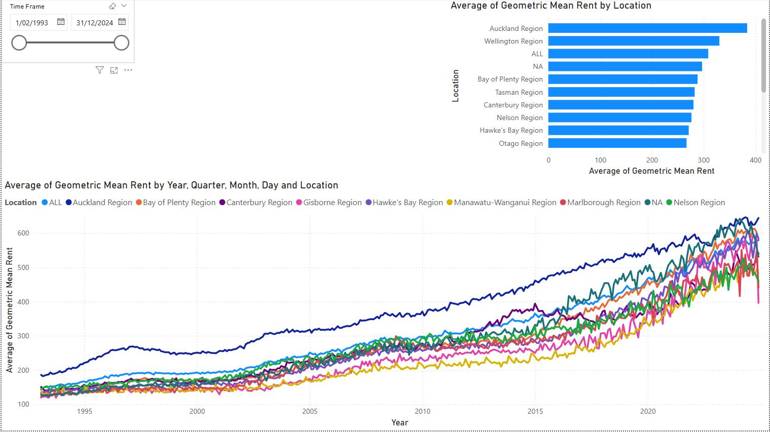
Regardless of period, Auckland has always maintained the highest average geometric rental rates.
Closer examination shows (especially from Dec 2014 – Dec 2024) dramatic increases in rental rates associated with the Bay of Plenty Region (in orange). An incomplete measure in Power was being constructed to generate this metric but debugging took more then 5 minutes.
Notes:
Regardless of period, Auckland has always maintained the highest average geometric rental rates.
(2) Closer examination shows (especially from Dec 2014 – Dec 2024) that the rental averages increased dramatically for the Bay of Plenty Region.
(an incomplete measure in Power was being constructed to measure this but would have taken more then 5 minutes to debug so left as is)

Slide 7
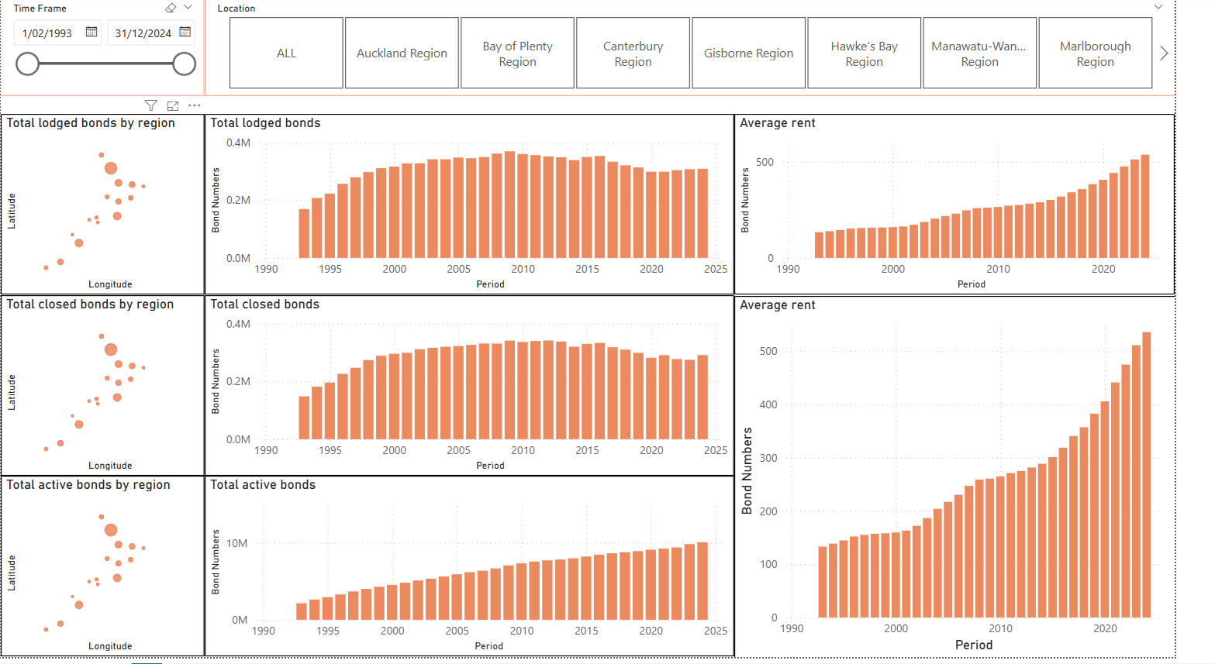
Notes:
This dashboard allows inspection of bonds data received per month.
Auckland once again has the highest number of closed/lodged/active bonds across 1993 – 2024 (which seems normal as over time it has represent a quarter to a third of the NZ population).
Average rentals has risen dramatically since 2018, previously it began an ascendancy between 2003 – 2008/9.
Possible correlative factors are increases in residency (immigration, birth) inline with possibly not enough housing which is influencing the demand/supply factors in the market on housing.
From an economic perspective, interest rates were historically low (before 2022) which could lend to increased property investment which overtime pushed housing prices and rents upward.
Inflation, rising interest rates since Covid (2022) onwards could also be lending towards landlords raising rents.
Policy changes such as Healthy homes standards (2019), IRD removing interest deductibility of invested properties (2021), and tenancy act reforms (2020) resulted in more risk and less profit from rentals. Also possibly resulting driving increased rents.
Also other impacts around the same time are that of AirBNB (short-term rentals replacing long-term tenures), the impact of COVID impacting the supply chain of materials, etc.

